Slide 1

Survival Analysis and Treatment Outcomes in Leukemia Patients
A Case Study using the Gehan Dataset
Presented by
Patrick Mensah
08/03/2023

Slide 2
OVERVIEW
Topic:
Survival Analysis and Treatment Outcomes in Leukemia Patients
The Gehan Dataset:
A rich source of information on remission times of leukemia patients.
Understanding Treatment Outcomes:
Investigating the impact of 6-mercaptopurine treatment on survival probabilities.
Why is this important?
Leukemia remains a critical health concern, and understanding treatment outcomes is vital for improving patient care.
Survival analysis provides a robust framework to analyze time-to-event data, revealing patient survival patterns and treatment effectiveness.
Our Objectives:
To analyze the Gehan dataset and explore its implications for leukemia treatment research.
To compare survival probabilities between treatment groups using Kaplan-Meier survival curves.
To perform statistical tests, including the log-rank test and Cox proportional hazards model, for insightful analyses.
To predict survival probabilities for new patients based on the fitted model.

Slide 3
INTRODUCTION
Leukemia is a type of cancer that affects the blood and bone marrow. There are different types of leukemia, with the four main types being acute myeloid leukemia (AML), chronic myeloid leukemia (CML), acute lymphoblastic leukemia (ALL), and chronic lymphocytic leukemia (CLL).
The remission time for leukemia patients can range from a few months to several years or more. Some patients may achieve complete remission, where no evidence of leukemia can be found in their body, while others may achieve partial remission, where the disease is significantly reduced but not completely gone. Additionally, some patients may experience relapse after a period of remission, which means the leukemia returns.
Treatment for leukemia often involves chemotherapy, radiation therapy, targeted therapy, and/or stem cell transplantation, depending on the type and stage of the disease. Advances in medical research and treatments continue to improve the outlook for leukemia patients, and ongoing clinical trials are exploring new therapies to further enhance remission rates and durations.

Slide 4
RESEARCH OBJECTIVES
To analyze the Gehan dataset and explore its implications for leukemia treatment research.
To compare survival probabilities between treatment groups using Kaplan-Meier survival curves.
To perform statistical tests, including the log-rank test and Cox proportional hazards model, for insightful analyses.
To predict survival probabilities for new patients based on the fitted model.

Slide 5
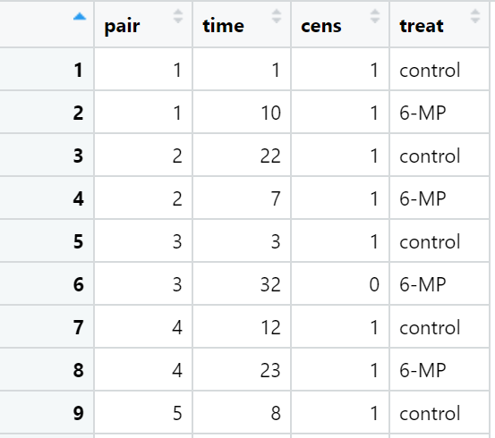
GEHAN DATASET
Overview:
The Gehan dataset comprises data from a trial involving 42 leukemia patients.
Patients were either treated with the drug 6-mercaptopurine (6-MP) or served as controls.
The trial was designed as matched pairs, with patients withdrawn when either came out of remission.
Columns in the Dataset:
pair: A label for each pair of patients.
time: Remission time in weeks.
cens: Censoring status (0 for observed events, 1 for right-censored events).
treat: Treatment group (control or 6-MP).
Purpose:
The dataset enables us to analyze and compare remission times and treatment outcomes between the control and 6-MP groups.
It serves as the foundation for our survival analysis and evaluation of leukemia treatment efficacy.
Significance:
Understanding the Gehan dataset's insights is critical for advancing leukemia research and improving patient care.
Through survival analysis, we can draw meaningful conclusions and make informed decisions for leukemia treatments.

Slide 6
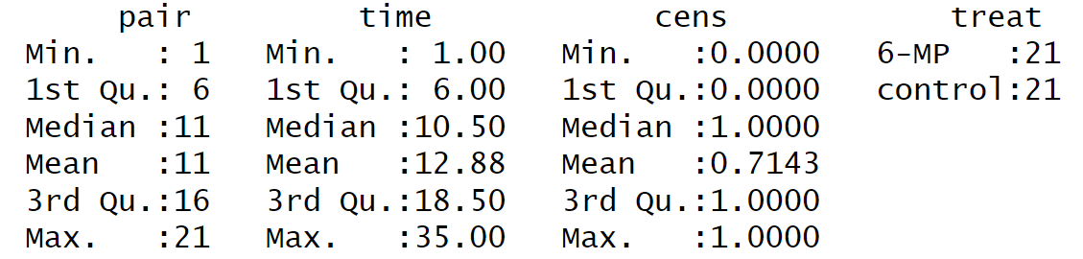
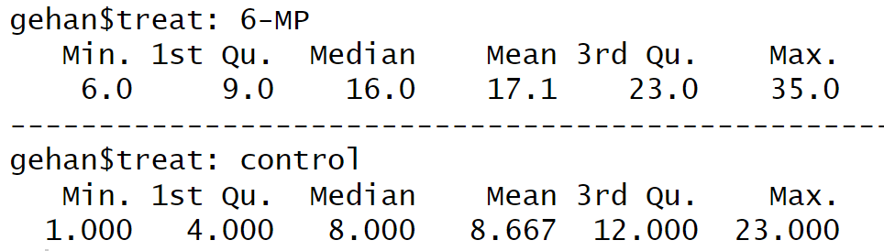
EXPLORATORY DATA ANALYSIS
Summary Statistics:
The dataset consists of 42 leukemia patients, evenly distributed between the 6-mercaptopurine (6-MP) and control groups.
Remission times range from 1 to 35 weeks, with a median of 10.5 weeks and a mean of approximately 12.88 weeks.
About 71.43% of the events are right-censored, suggesting that some patients' remission times are not fully observed.
Treatment Comparison:
For patients treated with 6-MP:
The minimum remission time is 6 weeks, and the maximum is 35 weeks.
The median remission time is 16 weeks, while the mean is approximately 17.1 weeks.
For patients in the control group:
The minimum remission time is 1 week, and the maximum is 23 weeks.
The median remission time is 8 weeks, with a mean of approximately 8.67 weeks.

Slide 7
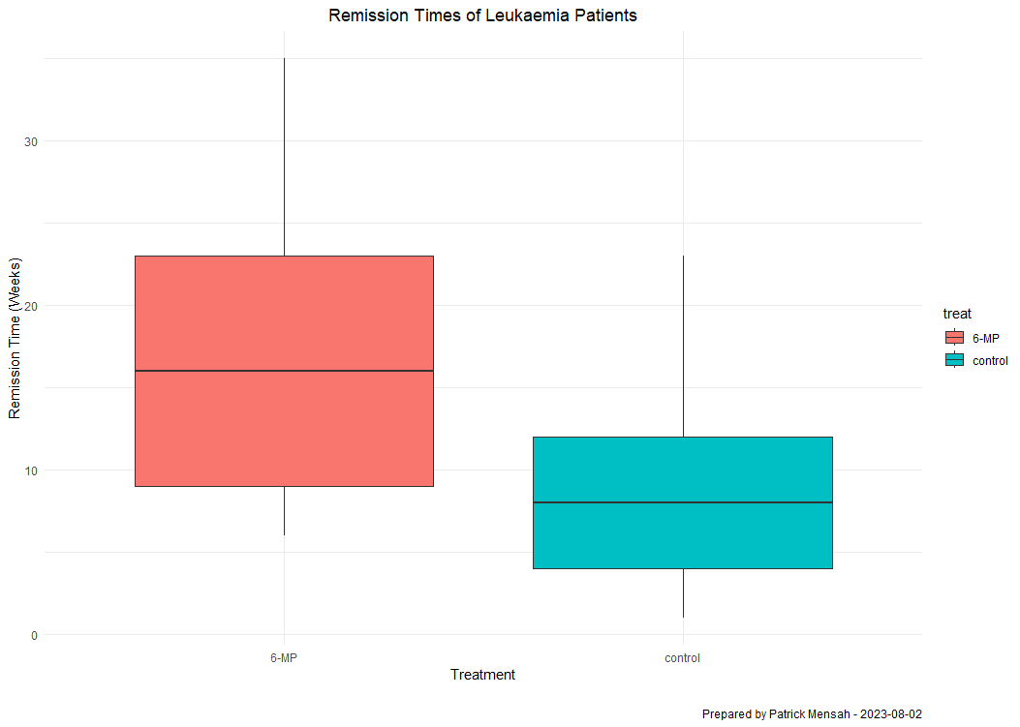
BOXPLOT COMPARING REMISSION TIMES BY TREATMENT GROUP
When comparing the treatment groups, patients treated with 6-MP have a longer median remission time of 16 weeks, with a mean of about 17.1 weeks. On the other hand, patients in the control group have a shorter median remission time of 8 weeks and a mean of approximately 8.67 weeks. These preliminary statistics shed light on the dataset's distribution and will serve as a foundation for further survival analyses and treatment comparisons.

Slide 8
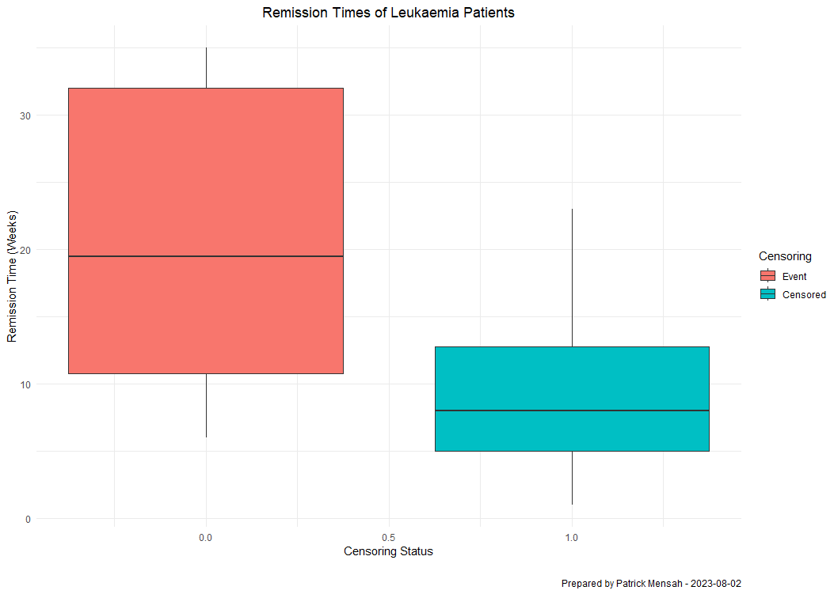
BOXPLOT COMPARING REMISSION TIMES BY CENSORING STATUS
When comparing the censoring status, patients who had the event have a longer median remission time of approximately 18 weeks,. On the other hand, patients who were censored have a shorter median remission time of 8 weeks. These preliminary statistics shed light on the dataset's distribution and will serve as a foundation for further survival analyses and censoring status.

Slide 9
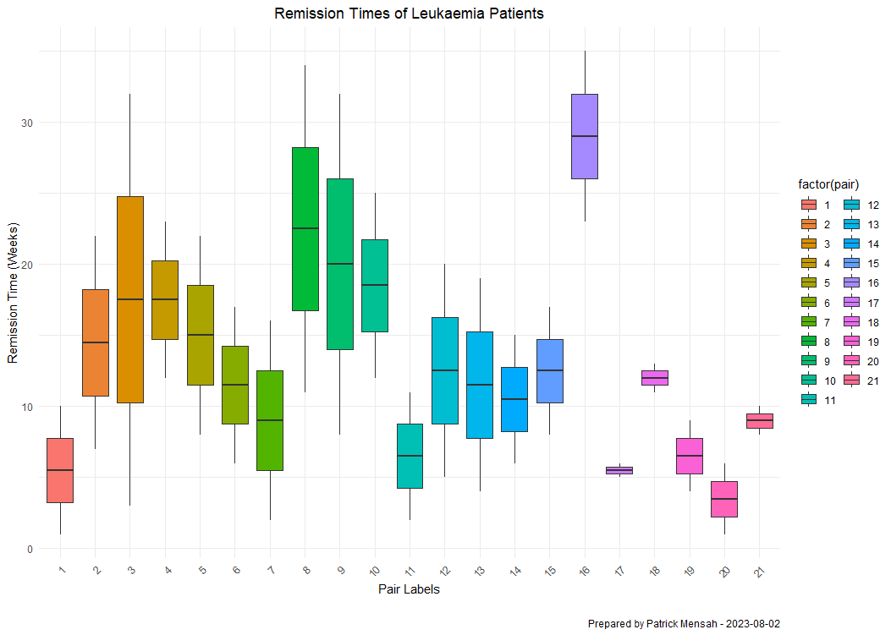
BOXPLOT COMPARING REMISSION TIMES PAIR LABELS
In the boxplot comparing remission times by pair labels, it is evident that pair number 17 exhibited the highest median remission time of approximately 28 weeks, signifying a potentially favorable treatment response. Conversely, pair number 20 had the lowest median remission time, approximately 4 weeks, indicating a relatively shorter treatment outcome. These observations underscore the variability in patient responses within the matched pairs and emphasize the importance of further investigation to understand the factors influencing treatment efficacy.

Slide 10
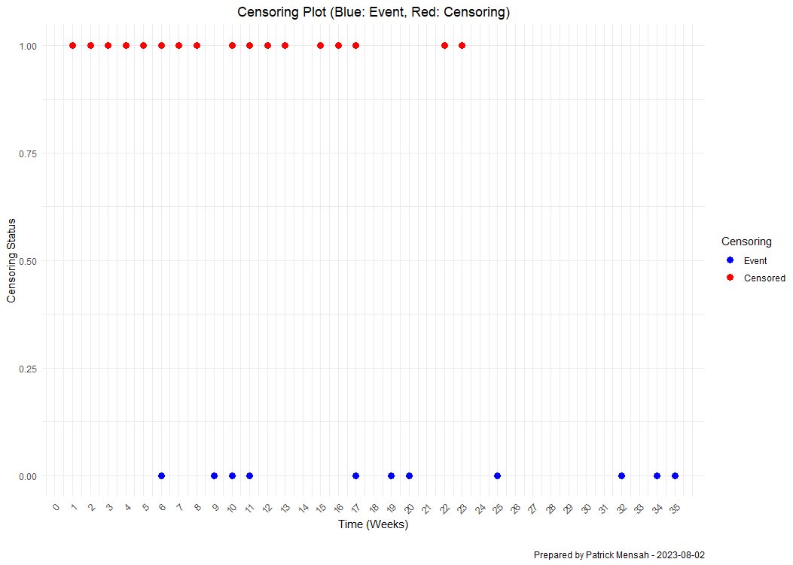
CENSORING PLOT OF LEUKEMIA PATIENTS
From the censoring plot, it is apparent that 17 patients experienced censoring, meaning their remission times were not fully observed, while 11 patients had the event, indicating that their remission times were observed before the end of the study. This combination of observed events and right-censored data provides critical information for survival analysis and helps us better understand the patient outcomes in the leukemia study.

Slide 11
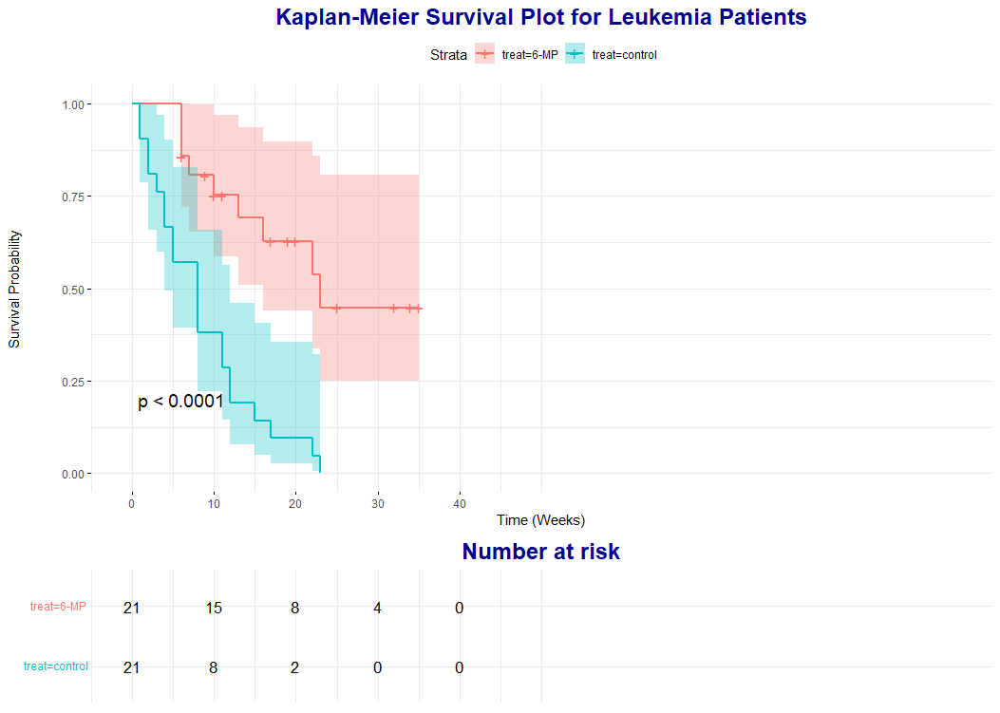
KAPLAN-MEIER SURVIVAL PLOT FOR LEUKEMIA PATIENTS
At week 0, 21 patients were at risk in both the 6-mercaptopurine (6-MP) and control groups.
At week 10, 15 patients treated with 6-MP and 8 patients treated with control were still at risk.
At week 20, 8 patients treated with 6-MP and 2 patients treated with control were at risk.
At week 30, 4 patients treated with 6-MP were at risk, and there were no patients at risk in the control group.
At week 40, there were no patients at risk in either the 6-MP or control group.
The log-rank test yielded a significant p-value of 0.0001 with a 95% confidence interval, indicating a substantial difference in survival rates between the two treatment groups. Notably, patients treated with 6-MP exhibited a higher survival rate of approximately 46% compared to those treated with control, suggesting the potential efficacy of 6-MP in improving leukemia patient outcomes.

Slide 12
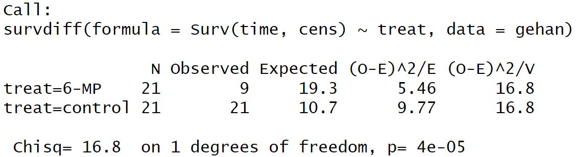
DATA ANALYSIS
THE LOG-RANK TEST
The log-rank test was performed to compare the survival distributions between the two treatment groups in the Gehan dataset. The test revealed a chi-squared statistic of 16.8 on 1 degree of freedom, resulting in a highly significant p-value of 0.00004. This indicates a substantial difference in survival rates between the patients treated with 6-mercaptopurine (6-MP) and those in the control group. The log-rank test is a powerful tool for assessing the impact of treatments on patient survival, and in this case, it highlights the potential efficacy of 6-MP in improving leukemia patient outcomes.

Slide 13
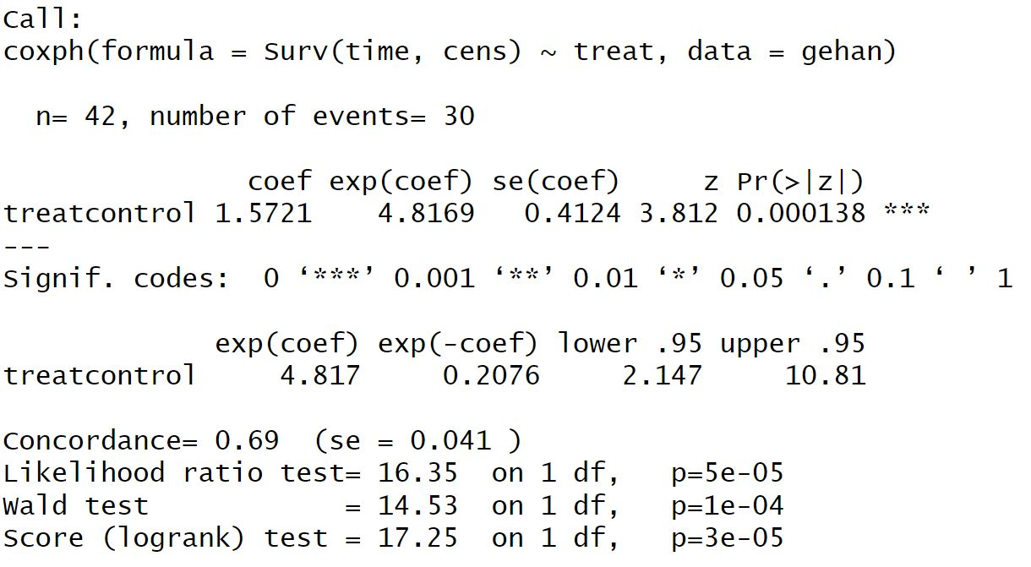
DATA ANALYSIS
COX PROPORTIONAL HAZARDS MODEL
The Cox Proportional Hazards Model was applied to assess the impact of the treatment variable on survival times in the Gehan dataset.
The significant p-values in all three tests (LR test, Wald test, and Score test) indicate that the treatment group variable has a strong and statistically significant effect on the hazard of relapse.
The hazard ratio of 4.817 means that the hazard of relapse is significantly higher in the 6-MP treatment group compared to the control group.
Overall, the Cox proportional hazards model confirms that the treatment group has a significant impact## on the survival outcome in the Gehan dataset, and patients in the 6-MP treatment group are at a higher risk of relapse compared to those in the control group

Slide 14
PREDICTED SURVIVAL PROBABILITIES FOR NEW PATIENTS
The Cox Proportional Hazards Model was employed to predict the likelihood of survival for new patients based on the analysis of the Gehan dataset.
For patients with remission times of 10, 20, and 30 weeks, the estimated survival probabilities are approximately 34.7%, 63.3%, and 2.0%, respectively.
These survival probabilities offer valuable insights into the expected outcomes for patients with different remission times and treatments, enabling healthcare professionals to make informed decisions about potential interventions and care plans for individual patients. The model's predictions serve as a valuable tool to assess the potential efficacy of treatments and aid in tailoring personalized therapeutic strategies for leukemia patients.

Slide 15
CONCLUSION
In this research work, we analyzed the Gehan dataset, which consisted of 42 leukemia patients treated with 6-mercaptopurine (6-MP) and a control group.
Our exploratory data analysis revealed significant differences in remission times between the treatment groups.
The Kaplan-Meier survival plot indicated a higher survival probability for patients treated with 6-MP compared to the control group, and the log-rank test confirmed the statistical significance of this difference.
Additionally, the Cox Proportional Hazards Model demonstrated that patients receiving 6-MP treatment had approximately 4.82 times higher likelihood of remission. These findings suggest that 6-MP treatment may positively influence leukemia patient outcomes.
Furthermore, we predicted the survival probabilities for new patients based on the model, providing valuable insights for personalized treatment planning. Overall, this research contributes to a better understanding of the effectiveness of 6-MP treatment in leukemia management and highlights the importance of survival analysis in clinical decision-making for improved patient care.

Slide 16
RECOMMENDATION
Based on the findings of this research work, we recommend further investigation and clinical trials to validate the effectiveness of 6-mercaptopurine (6-MP) treatment in leukemia patients, considering various prognostic factors and treatment modalities. Specifically, future studies should explore the impact of disease subtypes, genetic markers, co-morbidities, and drug combinations on treatment outcomes.
Additionally, optimizing dosing regimens, evaluating supportive care measures, and assessing the influence of age and gender on treatment responses can lead to personalized therapeutic strategies that enhance overall patient outcomes and quality of life.
Collaborative efforts among healthcare institutions and researchers are crucial to developing evidence-based guidelines that optimize leukemia management and improve patient survival rates.

